Slide 1
Homework Assignment #4
-- due: 14:20, Nov 17, 2016
3.1 Textbook, Problem 3.21. (attached in the next few pages)
3.2 Textbook, Problem 4.4.
3.3 Textbook, Problem 4.22.
3.4 Use OpenCV, or Matlab, or any software you like, to compute the Fourier transform of your own face image, and then perform some smoothing and sharpening operations of your choice. Print out the results and give some discussions.
作業繳交方式如下:
  1. 一個pdf檔，內含以上4題的結果（包含第4題的結果與討論）。
  2. 請將以上之pdf檔與source code放到一資料夾，並將資料夾以自己的學號命名後壓縮，壓縮檔也以自己的學號命名，然後在CEIBA上傳。

Slide 2
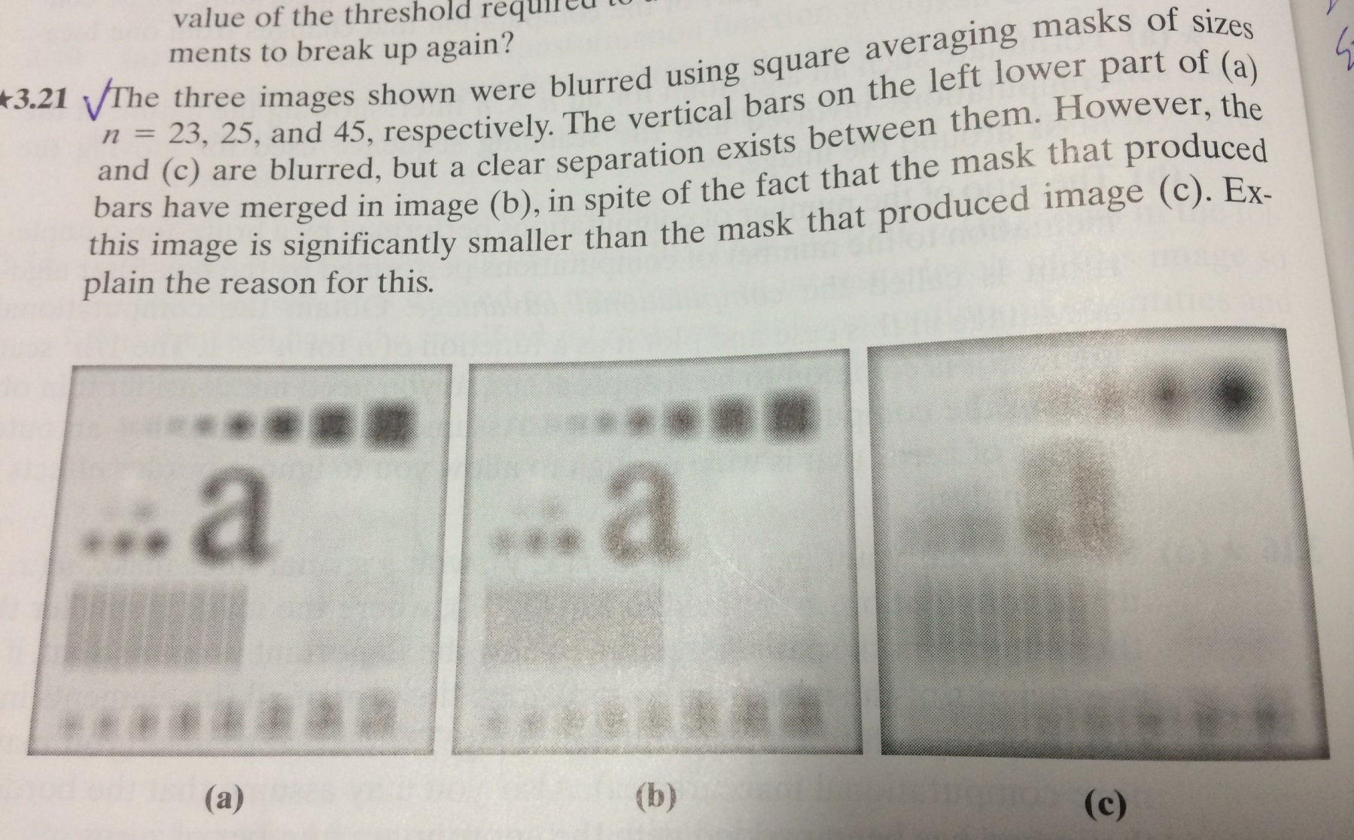

Slide 3
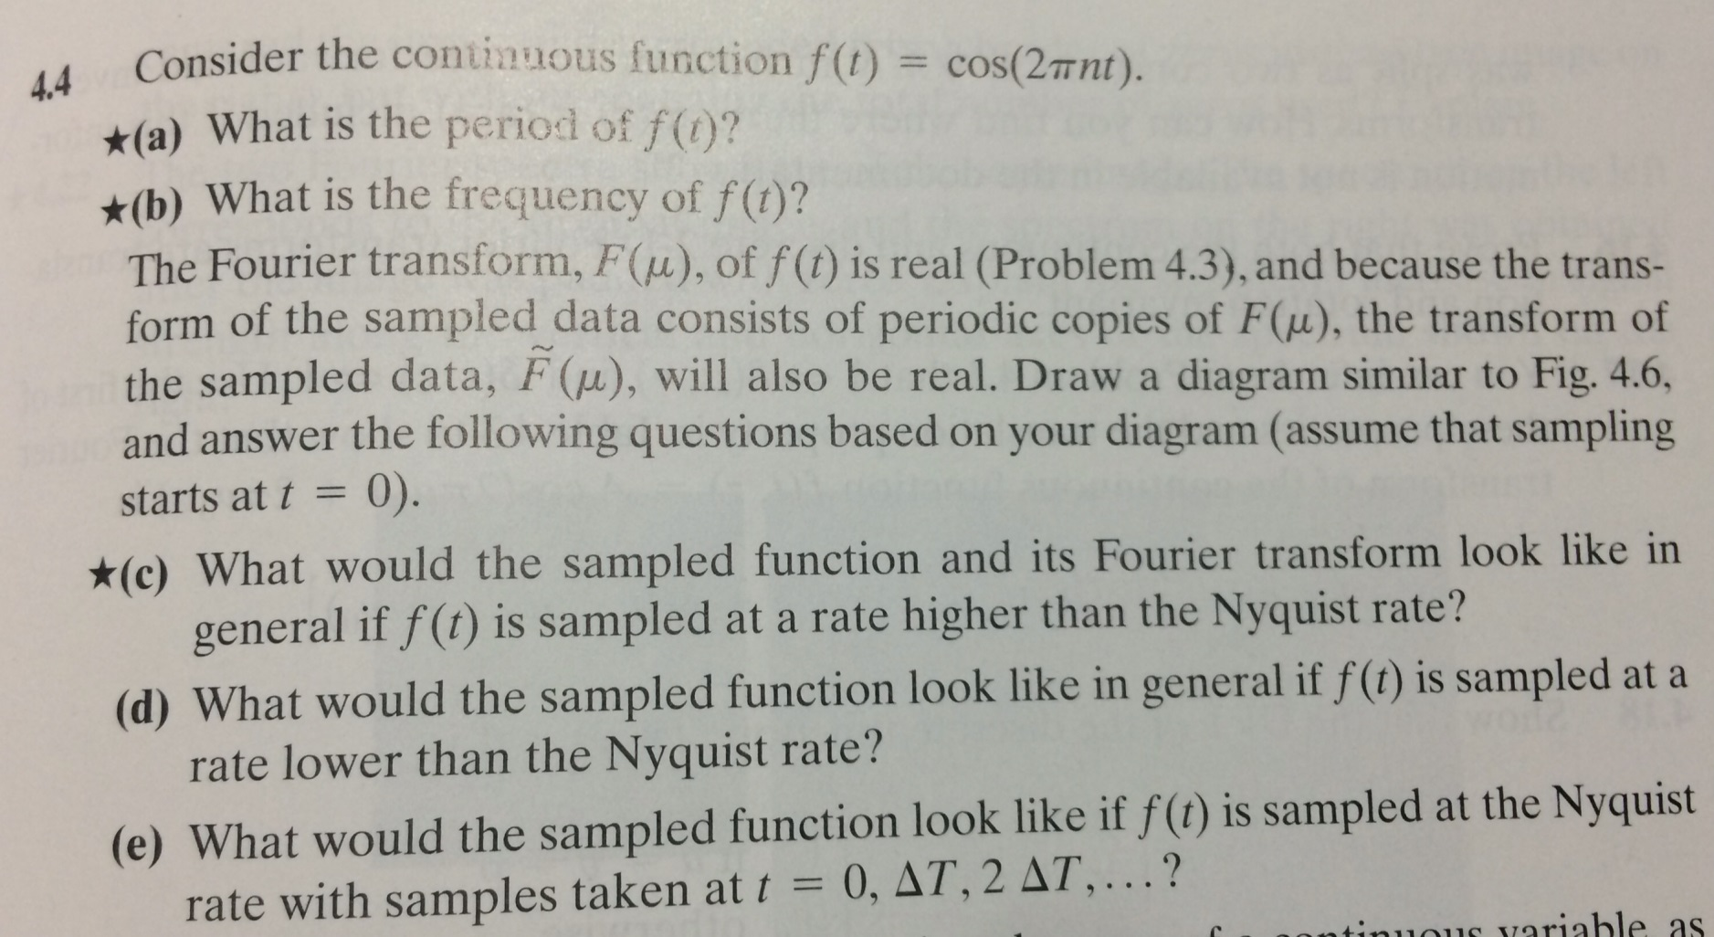

Slide 4
